Slide 1


Slide 2
Log4j[Logging for java]
In a java projects writing sop statements is discouraged, beacause of the following
reasons
1. SOP statement takes approximatly one second of time to print a message on console.
2. SOP statements are printed on console so they are temporary.
3. If there are more number of SOP statements then the statement will scrolled up on
console and we can't see all sop statements on console.
4. If an issue has occured in a project when it is executing at client location then it is
not possible to send the sop statements printed on console to the application support
group people.
As the solution for the aboue problems,Apache has interduced a tool Log4j.
In real time projects , we insert log statements using Log4j API instead of SOP
statements.
Log4j provides a logging API , which can be used to insert log statements and also to
print them on console or to store in a File or in a Database or they can be sent as an
Email to a mail account.

Slide 3
Main Components of Log4j :
1 Logger.
2. Appender.
3. Layout.
Logger:
• To define log statements in a java project , we need a Logger Object .
• Logger objects are one per each class.
• Log statements can be inserted in both static method and non-static methods.so we
need to create a static logger object in a class.
Syntax1:
static Logger logger =Logger.getLogger(Class c);
syntax2:
static Logger logger=Logger.getLogger(String classname);
for example: static Logger logger =Logger.getLogger(Test.class);
(or) static Logger logger =Logger.getLogger("Test");
Before inserting or writing a log statement in source code, a programmer must
choose some priority level.

Slide 4
Log statements are divided into 5 priority levels
debug
2. info
3. warn
4. error
5. fatal
debug<info<warn<error<fatal
A control entry and exit into methods or blocks in source code are indicated with
"debug" level log statements.
When an application has extrablish the connection with external resources like Files
or Database or mail server or messaging server then the log statement is indicated
with info level.
When a buffer is going to reach to maximum capacity or when threads are reaching
to the maximum limit then a log statement will be written with warn level.
If an exception has occured in source code then we insert a log statement with error
level in catch block.
If an unhandled problem has occured then we insert a log statement with fatal level.

Slide 5
Appender:
Appender is a component which receives log statement generated by java program.
Appender uses a layout component for formatting a log message.
Appender finally sends formatted log message to the destination.

Slide 6
Different Appender classes of log4j are
ConsoleAppender.
2. FileAppender.
3. JDBCAppender.
4. SMTPAppender.

Slide 7
Layout classes of Log4j:
PatternLayout.
2. HTMLLayout.
3. XMLLayout.

Slide 8
Log4j properties file:
In a java application we insert log statements through logger object with different
priority levels.
2. We need to construct either a properties file or an xml file to configure the following
◦ setting priority level for enabling log statements/
◦ selecting appropriate appender.
◦ Selecting appropriate layout for appender.
• Mostly we create a properties file if the file name is log4j.properties then it is
automatically loaded at runtime.
• If we put ant another name then it must be explicitly loaded into the source code
propertyConfigurator.configure("sathya.properties");

Slide 9
a sample log4j.properties file looks like the following.
Log4j.properties
#log4j.properties
#Define the root logger with appender
log4j.rootLogger=DEBUG,CA
#Define the console appender
log4j.appender.CA=org.apache.log4j.ConsoleAppender
#Define layout for the appender
log4j.appender.CA.layout=org.apache.log4j.PatternLayout
log4j.appender.CA.layout.ConversionPattern=%-5p %c -%m%n

Slide 10


Slide 11
Continue…
Pattern layout has ConversionPattern property and log4j has provided differnet
symbols for defining ConversionPattern.
1. %5p -->Prints 5 characters of priority level with rigth jestification.
2. %-5p -->Prints 5 characters of priority level with left jestification.
3. %t -->Prints thread name.
c -->prints Class name.
5. %L -->Prints Line number.
6. %m -->Prints message.
7. %r -->prints milliseconds lapced from program execution to reach the log statements.
8. %n -->New line.
9. %d{dd-MM-yyyy}-->prints data in dd-MM-yyyy format.
10.%d{hh-mm-ss}-->prints time in hh-mm-ss format.

Slide 12
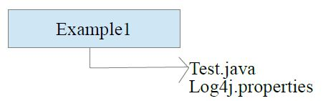
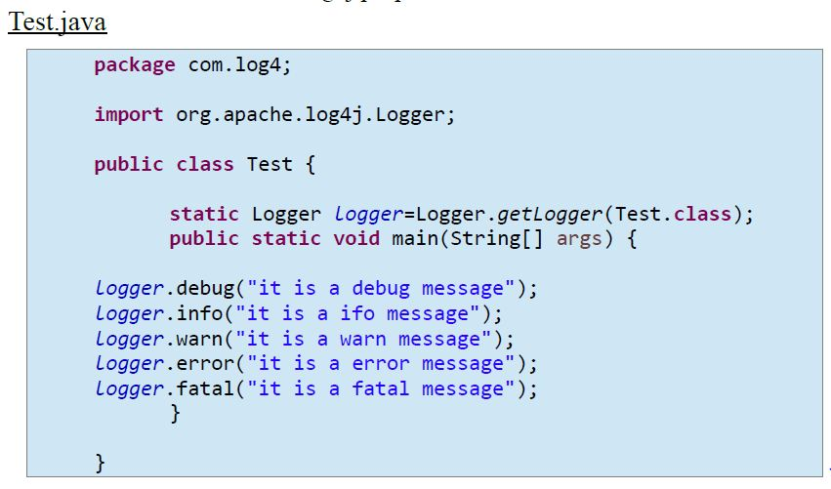

Slide 13
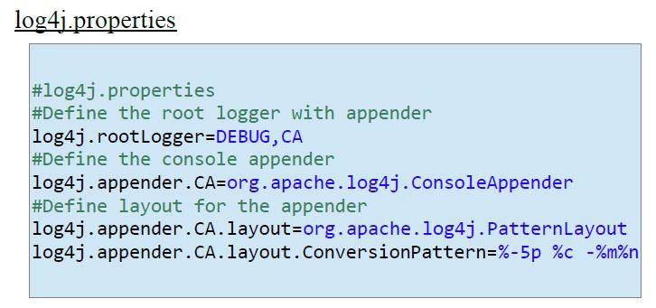

Slide 14
To work with log4j, we need to add log4j jar file to the classpath.
We can download log4j.zip from "https://logging.apache.org/log4j/1.2/download.html".
Extract the zip file and add log4j-1.2.17.jar to the classpath.
>set classpath=D:\apache-log4j-1.2.17\log4j-1.2.17.jar;.
>javac Test.java
>java Test

Slide 15
Types of FileAppender:
FileAppender has subclassed into two types.
1. RollingFileAppender.
2. DailyRollingFileAppender.
If we want to set maximum size for a log file and if we want to send log data to a
backup file when it is full then we use RollingFileAppender.
If we want to maintaine a separate log file for each system date then we use
DailyRollingFileAppender.

Slide 16
A properties file for RollingFileAppender looks like the following
For DailyRollingFileAppender:

